Slide 1
Postmodernism Poststructuralism
14 May 2020
GENTRAIN
MONTEREY PENINSULA COLLEGE
STEPHANIE SPOTO

Slide 2
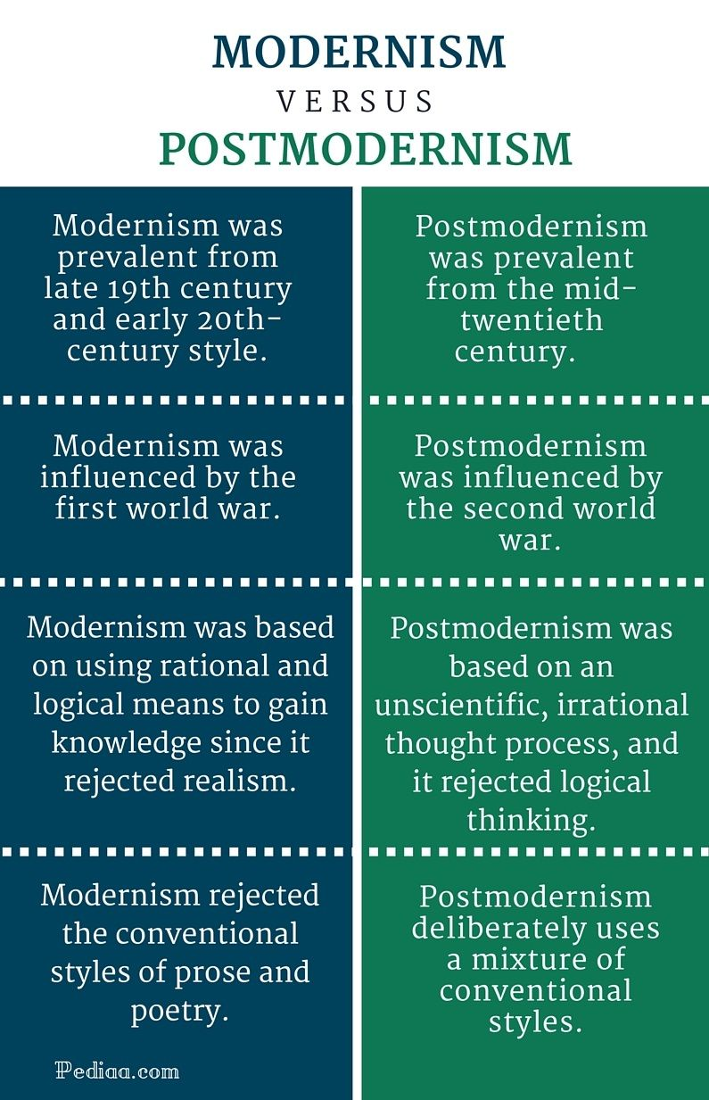
Postmodernism – what is it?
Indefinable?
Set of strategic critical and rhetorical methods
Uses its developed concepts of the simulacrum, hyperreality, difference, repetition, etc. to challenge and destabilize modernity and its notions of historical progress, certain knowledge, and the stability and universality of meaning
Values irony, skepticism. Rejects grand narratives and ideologies associated with modernism → critical of the Enlightenment
Explores how ideology maintains political and economic power (c.f. Gramsci, ‘hegemony’)
Value systems and knowledge are socially-conditioned → emerged from political, cultural, or historical hierarchies, ideologies and discourses
Critical of universalism, notions of objective reality, truth, human nature, language, science, and morality
Characterized by epistemological and moral relativism, pluralism, and irreverence

Slide 3
French and Italian strains
Coined in 1979, Jean-François Lyotard’s The Postmodern Condition
French post-modernists are often responding to concepts developed by structuralism in 1950s-1960s (including interpretations of Marx and Freud)
This branch of post-modernism is often called post-structuralism
Influenced by the May 1968 demonstrations → a period of rebellion after the uniting of the communists and the socialists against the state
Italian post-modern philosophers draw from Giambattista Vico and Benedetto Croce → historical emphasis
Rather than focus on a revolutionary movement, they center continuity and narrative, rather than counter-strategies
Neither of these schools of thought saw themselves as attacking modernity, but thinking through modernity differently.

Slide 4
Structuralism sociology, linguistics, anthropology
Methodology that explores human culture to understand it through its relationship to larger structures/systems
Seeks out an underlying structure that is the foundation for everything that humans do, perceive, feel, and think
It is possible to understand human culture through a structure modeled on language (structural linguistics).
Mediates between abstract ideas and concrete reality → focuses on relationships

Slide 5
Post-Structuralism
Roland Barthes Jean Baudrillard Judith Butler | Jacques Derrida Michel Foucault Gilles Deleuze Julia Kristeva
Post-structuralist philosophers present various challenges to structuralism
Common themes:
Critique/rejection of the self-sufficiency of structures
Challenge to the binary oppositions that make up the structures
Post-structuralists were critical of the structuralist assumption that one could build meaning from the relationship between signs → meaning is not fixed → structuralist author is not above the structures they are describing
A common target of post-structuralism is the structuralist tendency towards categorization and seeking/knowing universal truths

Slide 6
Origins of Post-Structuralism
In the 1960s, many French thinkers had started noticing/discovering tensions in structuralism
Jacques Derrida, “Structure, Sign, and Play in the Discourse of the Human Sciences”(lecture, 1966): argued that there was a rupture in intellectual life
This was a “decentering” of the previous philosophical cosmos
Rather than this being the result of progress from the center, Derrida thought of this “event” of decentering as a kind of “play”
Roland Barthes, “Death of the Author” (essay, 1967): the “death” of the author as a source from which we can find authentic meaning
Any text has a plurality of meaning → meaning does not rest in the author but the reader
Death of the author was the birth of the reader as the source for meaning

Slide 8
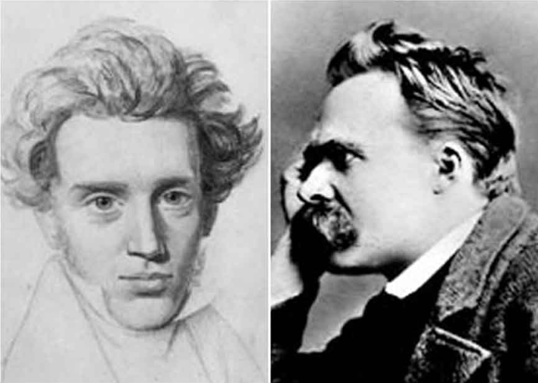
From Post-Structuralism to Post-Modernism
In the 1970s, post-modernism began to develop out of post-structuralism in France
Became a radical challenge to modern philosophy
Has some roots that are visible in:
Nietzsche: God is Dead – death of the world of ideas, questioning universal morality
Kierkegaard: questioned the conditions of modernity, not interested in ethics, but in ethical responsibility, subjectivity, deconstruction
By the 1980s, post-modernism has spread to the English-speaking world and to America.
Brought new and critical methods of thought that pushed philosophy into new areas

Slide 9
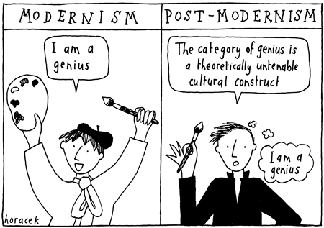
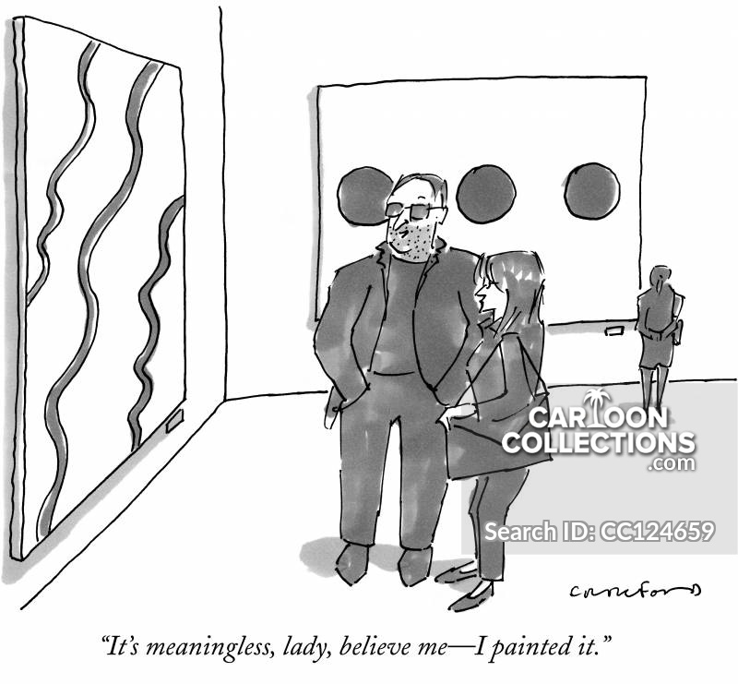
Postmodernism against Truth
Postmodernism rejects the “universal validity” of stable identity, binary oppositions, categorization, and hierarchy (Zygmunt Bauman, Intimations of postmodernity, 1992)
Take a skeptical approach to explanations that claim to be universal to all groups, cultures, races, and traditions → truth and meaning are relative and culturally situated
Enlightenment philosophy: through reason we can have access to objective knowledge
Post-modern philosophy: all access to reality is mediated; rejection of objective rational knowledge because interpretations are always subjective
Postmodernism: reaction against objective claims to the explanation of reality → reality is a social/mental construct
Postmodern philosophy of science/Postmodern scientists: facts and scientific “truth” is socially constructed rather than a metaphysical truth

Slide 10
Postmodernism’s influence from Critical theory
Postmodernism turned to critical theory in the 90s (theorists like Gramsci)
Consider the impact of ideology, history, society on culture
Both are critical of universalist notions of morality, truth, objective reality, reason, human nature, language, and social/historical progress
At first post-modernism was a literary theory → focusing on meaning and interpretation of a text
In the latter half of the twentieth century, began to influence philosophy, arts, etc.
Developed concepts such as:
Simulacrum: (“Simulacra and Simulation” 1981, Jean Baudrillard): society has replaced meaning with symbols → we live in that simulation → nothing like reality is important for understanding our lives
Hyperreality: the inability of consciousness to distinguish between reality and simulation
Difference: how one entity is distinguished between another in a conceptual system. For example, difference relates to both meaning and identity; identity is viewed as non-essentialist (a construct) and constructed only produce meaning through the relationship of difference → identity cannot exist without difference.

Slide 11
Abandoning rationality
Epistemic claims and value/moral systems are socially conditioned/contingent → they are the result of historical, cultural, or political discourses
Interested in emotions and irrationality → Influenced by psychoanalyst Jacques Lacan who claimed that rather than being inferior and primitive, the subconscious is just as sophisticated and complex as the conscious mind
Most criticisms of postmodernism center on this aspect
Postmodernism is meaningless and adds nothing to either empirical or analytical knowledge
Michael Oakeshott and Leo Strauss (conservative theorists): postmodernism is an abandonment of the rationalist project believed to be the central project of human progress and development

Slide 12
Critiques of post-modernism
Vagueness: Noam Chomsky claims that postmodernism is meaningless because it is so vague.
“Seriously, what are the principles of their theories, on what evidence are they based, what do they explain that wasn't already obvious, etc? These are fair requests for anyone to make. If they can't be met, then I'd suggest recourse to Hume's advice in similar circumstances: to the flames.” (Chomsky)
Richard Dawkin’s uses the following passage from Felix Guatarri to point to this vagueness:
“We can clearly see that there is no bi-univocal correspondence between linear signifying links or archi-writing, depending on the author, and this multireferential, multi-dimensional machinic catalysis. The symmetry of scale, the transversality, the pathic non-discursive character of their expansion: all these dimensions remove us from the logic of the excluded middle and reinforce us in our dismissal of the ontological binarism we criticised previously” (Guatarri, Chaosmosis: An Ethico-aesthetic Paradigm)
Moral relativism: many conservative thinkers reject postmodernism on the grounds of its moral relativism → rejects what they see as natural and religious truths

Slide 13
Critiques of post-modernism
Marxian criticisms: in its refusal to recognize anything as objective, postmodernism criticized by Marxists
Alex Callinicos and John Molyneux (both of the Socialist Workers Party) critique postmodern theorists as disillusioned revolutionaries who joined the ranks of the bourgeois intellectuals
Frederic Jameson: postmodernism is a failure because it fails to address the metanarratives of capitalism → this makes it complicit in oppression and capitalist domination
Sokal affair: Alan Sokal’s postmodern article in Social Text
NYU physics professor wrote bogus and nonsensical articles that used similar rhetoric and style to the predominate postmodern theorists
The same day as the publication in Social Text, published another article explaining his motivation to write the nonsensical article was to discredit the philosophy

Slide 14
Sources & Resources
Gary Aylesworth, “postmodernism” Stanford Encyclopedia of Philosophy: https://plato.stanford.edu/entries/postmodernism/
Paul Fry, “The Postmodern Psyche”, video lecture: www.youtube.com/watch?v=P1M9-xk-BVg
Michel Foucault and Noam Chomsky. The Chomsky-Foucault Debate: https://www.youtube.com/watch?v=3wfNl2L0Gf8
Please don’t watch anything by Jordan Peterson. He doesn’t know what he’s talking about

